Slide 1
Friendship between two doubleW’s
Ivan Ružević
ivan.ruzevic@infinum.co

Slide 2
We're an independent design & development
agency.

Slide 3
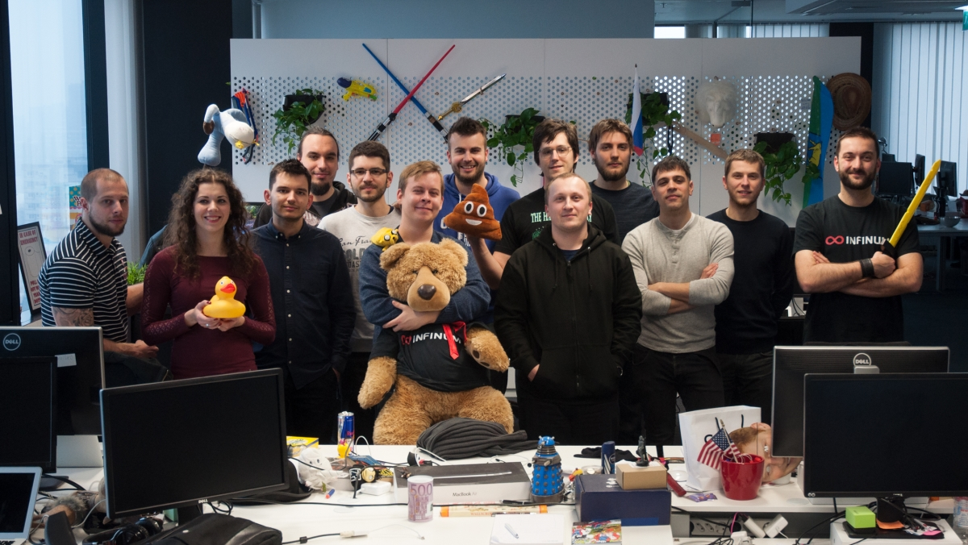

Slide 4
What will you get?
How I start all my WordPress Projects
Wp Boilerplate
Webpack and WordPress
Maybe it will help you
Notes:
going to show you how I start all my wp projects.
We created boilerplate to avoid setting up everything every time from the beginning.
Consistencies over the projects
New developer will know where to stat and it will be familiar to the new guy.

Slide 5
Who am I?
Started as a Designer
WP 2.8 (2009)
Over 100 projects behind me
10+ years experience in front-end dev.

Slide 6
What should every
WordPress project have?

Slide 7

Coding
standards
Javascript
Task
runner
Fonts
Images
version
control
Linters
SASS
pre-processor

Slide 8



Slide 9
02
Wp Boilerplate

Slide 10
What is in it?
Watch and Build Scripts
Webpack 3
ES Linting
Style Linting
PHP Error Check
WPCS Style Guide
BrowserSync
PostCSS
Readme
Build and Pre-build Bash Script
GitIgnore
Sass Files Structure
Pre-created Theme Files
General Helpers
Functions structure
BEM Menus
Google rich snippets
…

Slide 11
All Assets
Custom Fonts
Images
JavaScript
Sass

Slide 12

Sass
Based on Infinum’s Handbook
BEM Structure
Not Bootstrap
Use Mixins
…
Notes:
Hanbook not public yet but it will be soon.

Slide 13

PostCSS
Autoprefixer
Postcss Font Magician
Css Mqpacker
CssNano
…

Slide 14
Linting
Code Consistency
Quality Checks
Unused Assets
Error Checks
Coding Standards

Slide 15
WPCS
(WordPress Coding Standards)
Code Optimisation
Best Practices
Fixing Bad Code
Fixing Code Leaks
Infinum Code Sniffs
Notes:
What you might have heard

Slide 16
Theme and Plugins
Unlimited Plugins / Themes in One Build
PreCreated Theme Structure
Smarter Functions
Assets Version
Constant for Images
BEM Menu
…

Slide 17
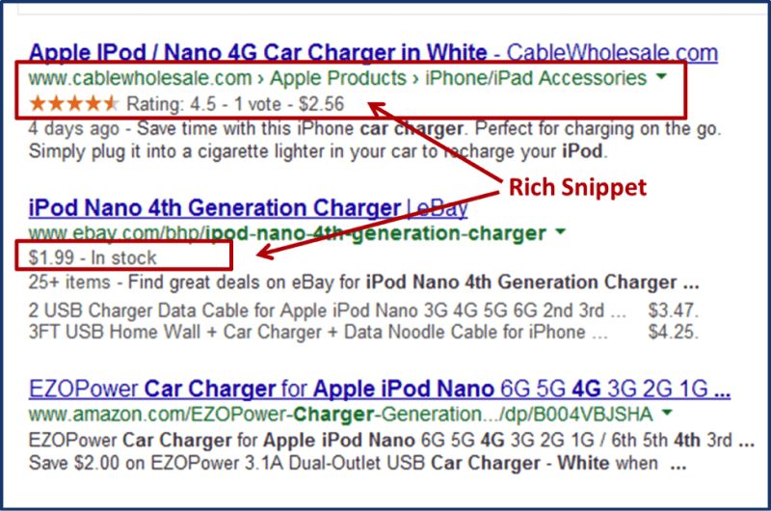
<!-- Google Rich Snippets -->
<script type="application/ld+json">
{
"@context": "http://schema.org",
"@type": "NewsArticle",
"mainEntityOfPage": {
"@type": "WebPage",
"@id": "https://google.com/article"
},
"headline": "<?php the_title() ?>",
"image": {
"@type": "ImageObject",
"url": "<?php echo esc_html( $image['image'] ); ?>",
"height": <?php echo esc_html( $image['height'] ); ?>,
"width": <?php echo esc_html( $image['width'] ); ?>
},
"datePublished": "<?php echo esc_html( get_the_time( 'c' ) ); ?>",
"dateModified": "<?php echo esc_html( date( 'c', strtotime( $post->post_modified ) ) ); ?>",
"author": {
"@type": "Person",
"name": "<?php echo get_the_author() ?>"
},
"publisher": {
"@type": "Organization",
"name": "<?php echo esc_html( get_bloginfo( 'name' ) ); ?>",
"logo": {
"@type": "ImageObject",
"url": "<?php echo esc_url( IMAGE_URL . 'meta-google.png' ); ?>",
"width": 220,
"height": 60
}
},
"description": "<?php echo esc_html( strip_tags( get_the_excerpt() ) ) ?>"
}
</script>
Google rich snippets

Slide 18
3 Bash Scripts
setup in 3min
_setup.sh
_prebuild.sh
_build.sh
Notes:
Continuous integration - travis, jankins, semafor

Slide 19
NPM Driven Development
Npm Install / Npm Start
Pre-commit Scripts
Build Scripts
No Vendor Folders (CopyWebpackPlugin)

Slide 20


Development Environment
Mamp, Lampp, Xampp
VVV (Varying-Vagrant-Vagrants)
Docker

Slide 21
Analyse your Assets
BundleAnalyzerPlugin
Assets sizes in graphics

Slide 22
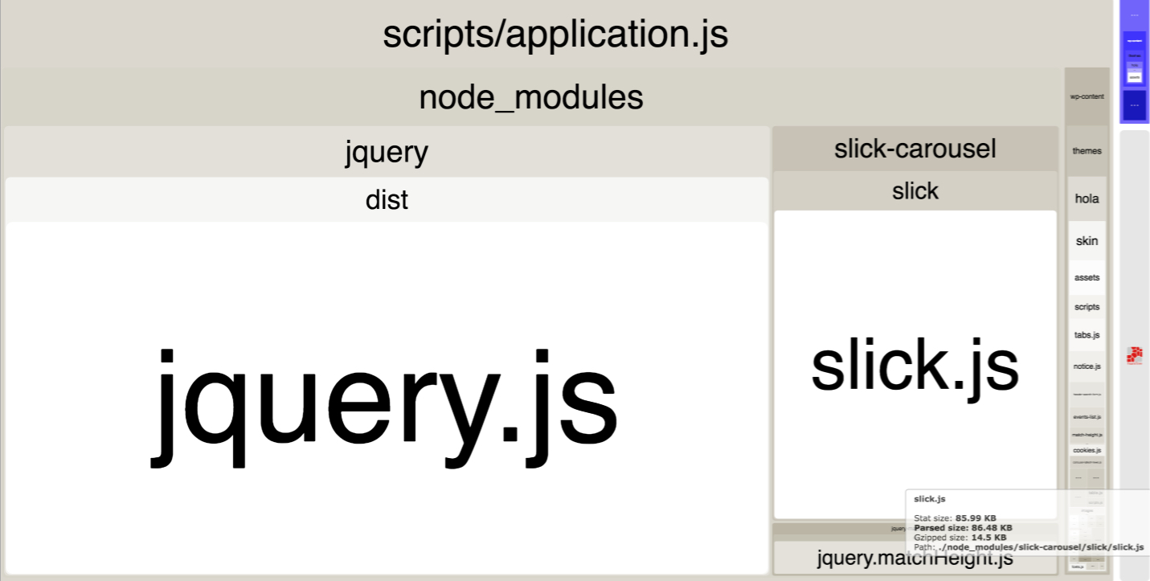

Slide 23

BrowserSync
Webpack Dev Server
Cross Devices
Watching Assets
Watching PHP
Super Fast

Slide 24
02
Why Webpack?

Slide 25
Personal Preferences!
Currently IN
Speed
Code splitting
JavaScript
A Lot of Plugins
Easy to Extend
Module bundler

Slide 26
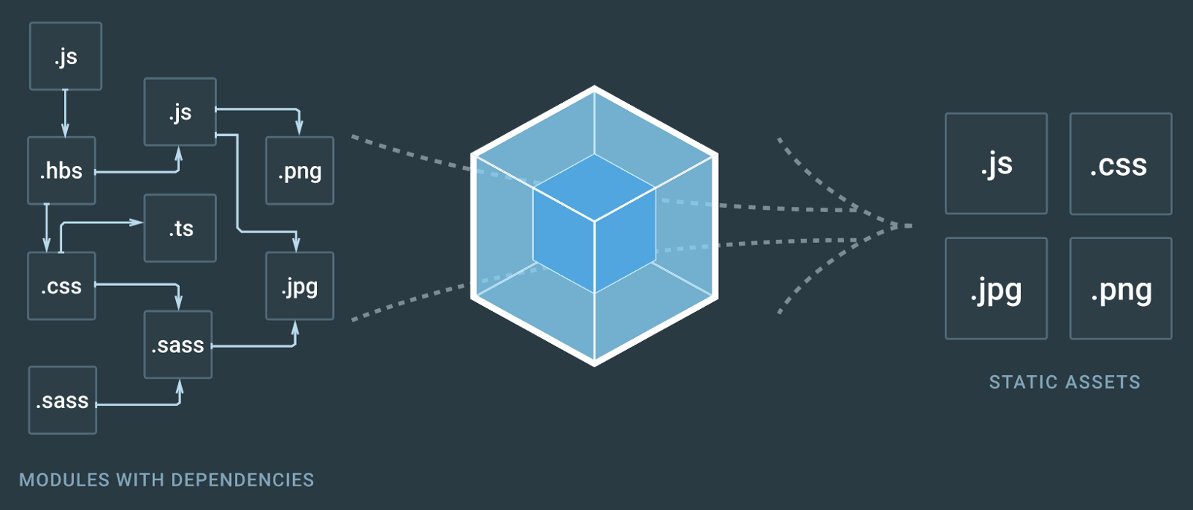
Webpack build process

Slide 27
Love Hate

Slide 28

Love Hate

Slide 29
Webpack vs Gulp vs Grunt Comparison
 | Webpack | Gulp | Grunt
Definition | Module bundler | Task runner | Task runner
Written in | Node.js | Node.js | Node.js
Monthly downloads | 4,582,941 | 2,796,320 | 1,895,345
Used by | 9GAG, Pinterest, Soundcloud, Flipboard, Airbnb, Udemy, 99 Designs, Assembly, etc. | Netflix, FashionUnited, Myntra, MakerBot, AdRoll, Ekimetrics, Trigger, CrowdFlower, etc. | Twitter, Adobe, jQuery, Mozilla, Bootstrap, Cloudant, Bitovi, Opera, LiveChat, Walmart, etc.
Notes:
Boilerplate uses only Webpack but if your project requires it you can use Webpack in combination with and task runner.

Slide 30
Require
const CleanWebpackPlugin = require('clean-webpack-plugin');
const ExtractTextPlugin = require('extract-text-webpack-plugin');
const UglifyJSPlugin = require('uglifyjs-webpack-plugin');
const BrowserSyncPlugin = require('browser-sync-webpack-plugin');
const CopyWebpackPlugin = require('copy-webpack-plugin');
const BundleAnalyzerPlugin = require('webpack-bundle-analyzer').BundleAnalyzerPlugin;

Slide 31
const allModules = {
rules: [
{
test: /\.(js|jsx)$/,
use: 'babel-loader',
exclude: /node_modules/
},
{
test: /\.json$/,
use: 'json-loader'
},
{
test: /\.(png|svg|jpg|jpeg|gif|ico)$/,
use: `file-loader?name=${outputImages}`
},
{
test: /\.(eot|otf|ttf|woff|woff2)$/,
use: `file-loader?name=${outputFonts}`
},
{
test: /\.scss$/,
use: ExtractTextPlugin.extract({
fallback: 'style-loader',
use: ['css-loader', 'postcss-loader', 'sass-loader']
})
}
]
};
Loaders For All

Slide 32
const proxyUrl = 'dev.boilerplate.com';
const allPlugins = [
new CleanWebpackPlugin([themeOutput]),
new ExtractTextPlugin(outputCss),
// Use BrowserSync For assets
new BrowserSyncPlugin({
host: 'localhost',
port: 3000,
proxy: proxyUrl,
files: [
{
match: ['wp-content/themes/**/*.php',
'wp-content/plugins/**/*.php']
}
]
})
// Analyse assets
new BundleAnalyzerPlugin(),
// Is using vendor files, but prefered to use npm
new CopyWebpackPlugin([{
from: `${pathTheme}/assets/scripts/vendors`,
to: `${pathTheme}/public/scripts/vendors`
}])
];
Plugins For Everything

Slide 33
const outputJs = 'scripts/[name].js';
const outputCss = 'styles/[name].css';
const outputFile = '[name].[ext]';
const outputImages = `images/${outputFile}`;
const outputFonts = `fonts/${outputFile}`;
module.exports = [
// Theme Skin
{
context: path.join(__dirname),
entry: {
application: [themeEntry],
applicationAdmin: [themeAdminEntry]
},
output: {
path: themeOutput,
publicPath: themePublicPath,
filename: outputJs
},
module: allModules,
plugins: allPlugins
}
];
Extendable
Assets

Slide 34
03
Conclusion

Slide 35
WordPress + Webpack
Great Fit
A Lot of Benefits
Let’s start building WordPress with this awesome tool!

Slide 36
WP Boilerplate
https://github.com/infinum/wp-boilerplate

Slide 37
Helpful Resources
webpack.js.org
webpack-when-to-use-and-why
gulp-vs-grunt-vs-webpack
postcss
browser-sync-webpack-plugin
wordpress-bem-menu
infinum-coding-standards-wp

Slide 38
Any questions?
ivan.ruzevic@infinum.co
@ mustra1
Visit infinum.co or find us on social networks:
infinum.co infinumco infinumco infinum

